Slide 1
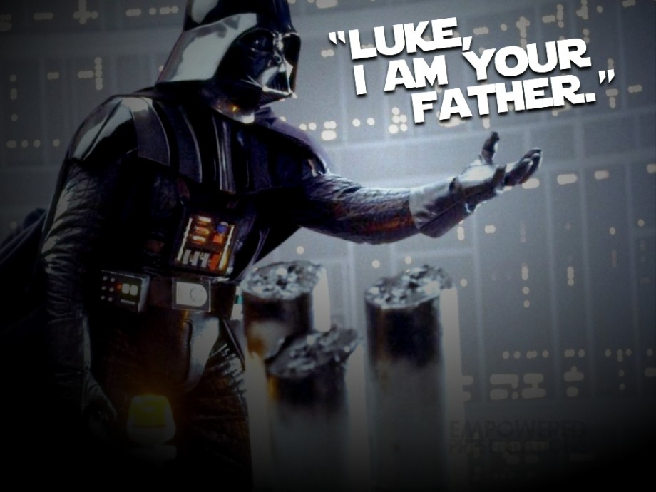

SPOILER DETECTION FROM MOVIE REVIEWS
Group P24
Prathamesh Pandit (pppandi2)
Rohit Nair (rnair2)
Sanveg Rane (ssrane2)
Saurabh Mhatre (smhatre)

Slide 2
Introduction
Spoilers can make a good movie lose its essence
Can use Machine Learning techniques to detect spoilers
Need to understand semantic meaning of text and compare texts
Can make use of Neural Network Processing Techniques
Traditional NNs do not take previous state into consideration
Need to make use of Recurrent Neural Networks
Two Approaches – MaLSTM and ESIM

Slide 3
Related Work
Enhanced LSTM for Natural Language Inference
Empirical Evaluation of Gated Recurrent Neural Networks on Sequence Modeling
Long Short-Term Memory
Siamese Recurrent Architectures for Learning Sentence Similarity
Sequence to Sequence Learning with Neural Networks

Slide 4
Method – Dataset Introduction
IMDB Spoiler Dataset from Kaggle
Dataset consists of 2 parts –
Movie Dataset which contains information about movies
Review Dataset which contains information about reviews
Dataset Statistics -
Review Dataset records - 573913
Movie Dataset records - 1572
• Reviews containing spoilers - 150924
Attributes of interest
Movie Synopsis and Movie Summary from Movie Dataset
Review Text from Review Dataset

Slide 5
Method – Data Preprocessing
Movie Synopsis and Summary contained similar information
Needed to perform attribute selection
Created 3 sets of data during initial run for analysis –
Using only Movie Synopsis and Review Text
Using only Movie Summary and Review Text
Using both Movie Summary and Synopsis along with Review Text
Achieved better accuracy using only Movie Synopsis

Slide 6
Method – Data Preprocessing
Random sampling
Stratified Sampling to select a subset of data
Selected reviews such that reviews containing spoilers and reviews not containing spoilers were equally represented
Also performed word embedding using Google’s pre-trained word and phrase vectors trained using word2vec
Dataset split for various stages –
Training – 76.8 %
Validation – 19.2 %
Testing – 4 %

Slide 7
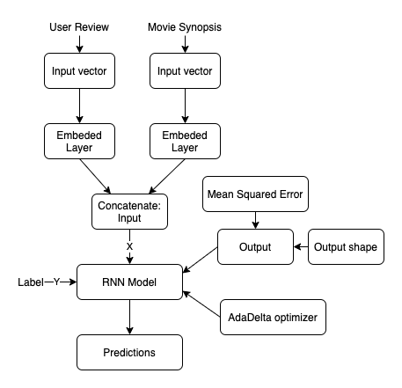
Method – Experimental Design Setup
Long Short-Term Memory
Special RNNs helpful for sequential data like text
Capable of learning long term dependencies
Pre-processed input data
RNN Models:
Manhattan LSTM (MaLSTM)
Enhanced Sequential Inference Model (ESIM)
Optimizer – AdaDelta / Adam

Slide 8
Method – Manhattan LSTM
Uses two LSTMs to measure similarity between sequences
Variable length sequences converted to fixed dimensional vectors
Similarity function is applied on top of these vectors to compute similarity
Calculates Manhattan distance
Loss function – Mean Squared Error
Adam optimizer to update network weights efficiently and iteratively

Slide 9
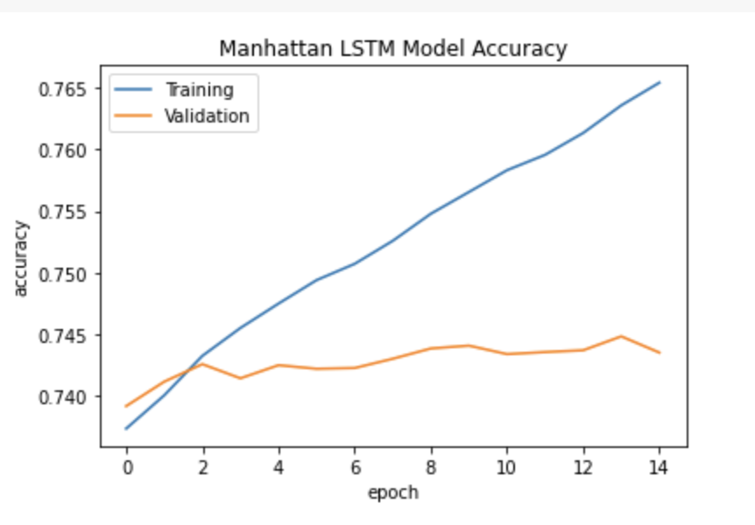
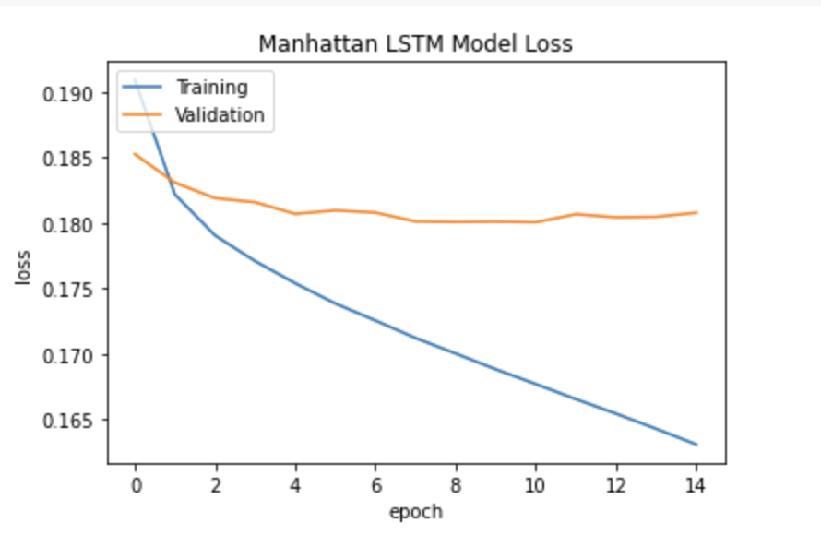
Results – Manhattan LSTM
 | Precision | Recall | F1-Score
Not Spoiler | 0.76 | 0.98 | 0.86
Spoiler | 0.75 | 0.13 | 0.22

Slide 10
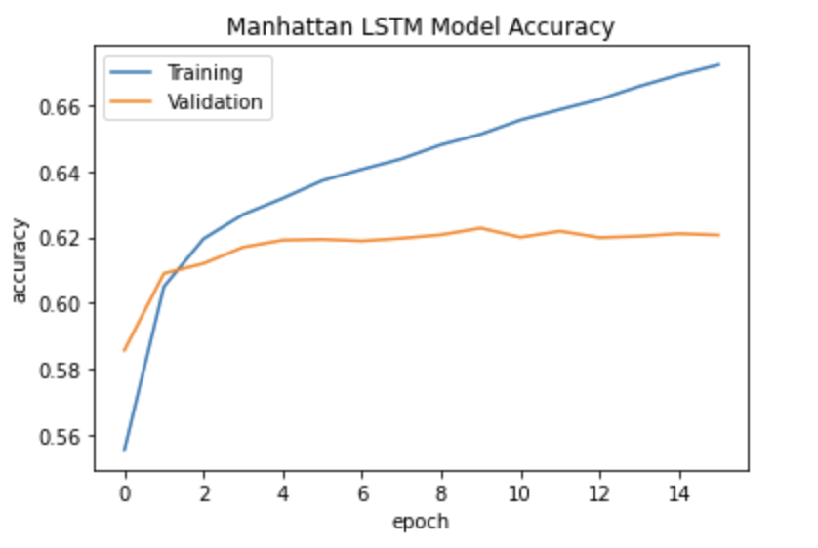
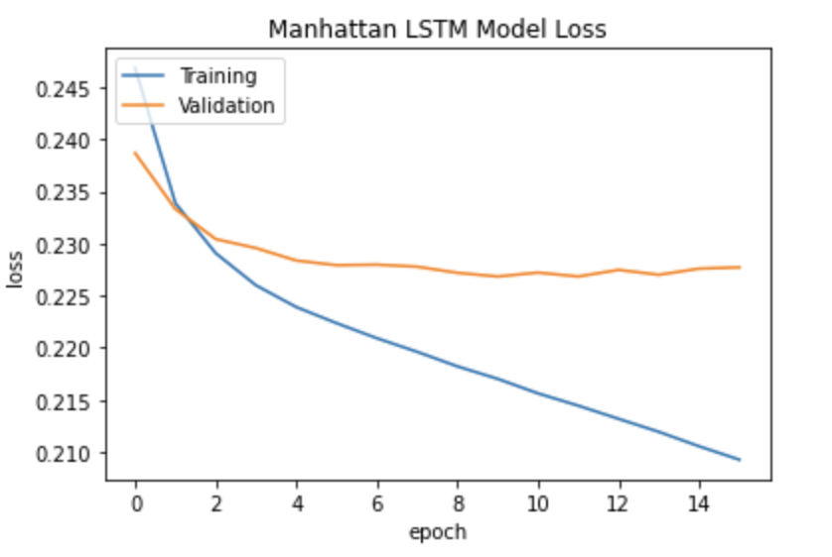
Results – Manhattan LSTM (Stratified)
 | Precision | Recall | F1-Score
Not Spoiler | 0.62 | 0.57 | 0.60
Spoiler | 0.60 | 0.65 | 0.62

Slide 11
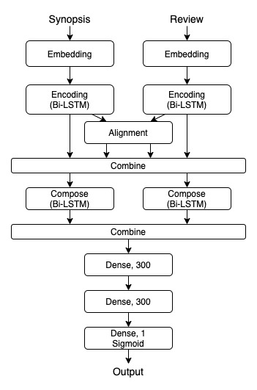
Method - ESIM
Enhanced Sequential Inference Model (ESIM)
Leverages BiLSTM for Natural Language Inference
Infers semantic similarity between encoded vectors using several layers of processing, some of which are as follows –
Input Encoding Layer
Local Inference Modeling
Composition layer
Fully Connected Layer
Good measure of model performance – F1 accuracy
Stratified Sampling produced better results

Slide 12
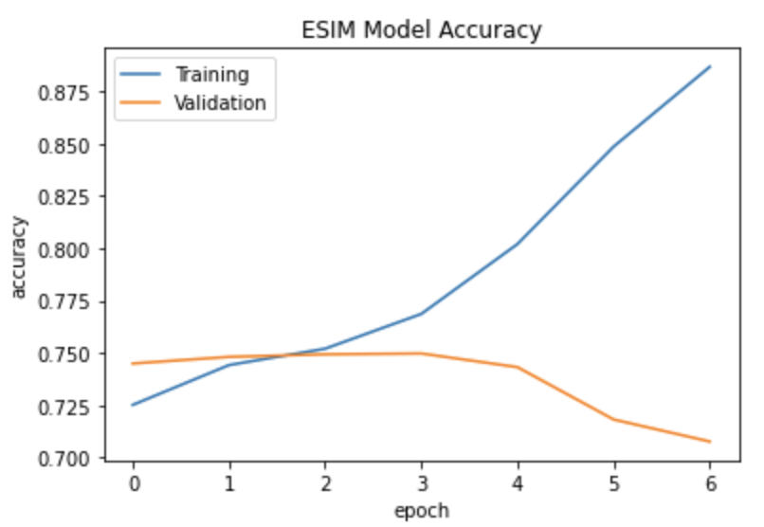
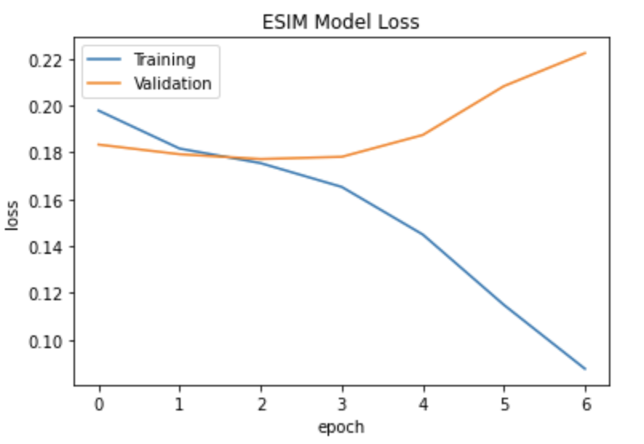
Results - ESIM
 | Precision | Recall | F1-Score
Not Spoiler | 0.78 | 0.95 | 0.86
Spoiler | 0.67 | 0.27 | 0.39

Slide 13
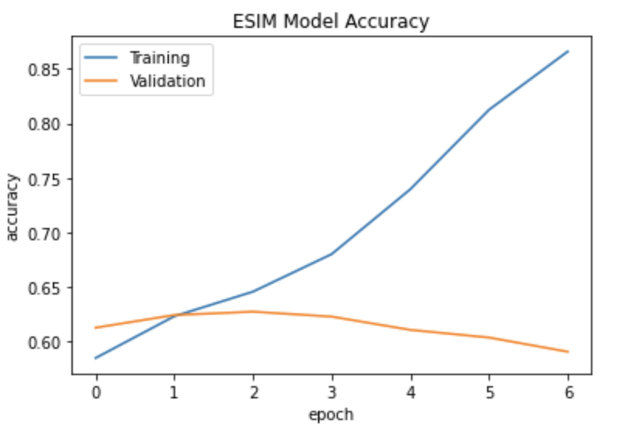
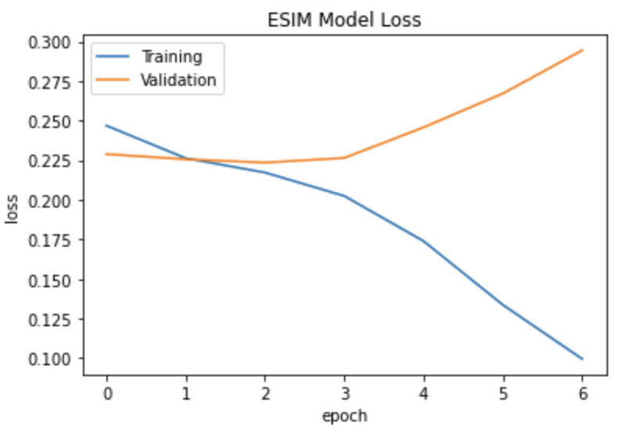
Results – ESIM (Stratified)
 | Precision | Recall | F1-Score
Not Spoiler | 0.63 | 0.60 | 0.61
Spoiler | 0.62 | 0.65 | 0.63

Slide 14
Discussion
Performance for detecting spoilers is influenced by techniques for text comparison, be it simple similarity measurements of encodings or attempting to generate complex semantic and logical meaning
Class Distribution of sample data is important for proper training for textual datasets as observed from improved F1 and recall scores after stratified sampling
Room for improvement:
Hyper Parameter Tuning
Additional Model Ensembling Techniques

